Slide 1

nat5 Design & Manufacture
The Design Team

Slide 2


Learning intentions & success criteria
Learning Intentions
An introduction to the different members of the design team.
The individual members’ role in the design team.
Success Criteria
State the names of at least 3 different members of the design team.
Describe their role in the design team.

Slide 3



The design team
A design team is a group of people brought together to design a product.
Each member of the design team will have certain skills or experiences which will allow him or her to specialise in one aspect of the design.
Each member of the design team will then have responsibility for a certain part of the design.
The following slides will go through each of the different design team members and explain their role.

Slide 4
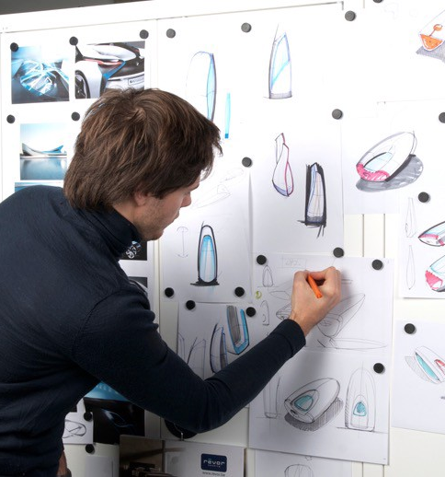
designers
Designers are integral throughout the entire process.
They conduct research, sketch ideas, develop their ideas, produce a final design, and create multiple physical and virtual prototypes to test their design.
They are responsible for how the final product looks and functions.
Designers must collaborate with all the other design team members to ensure the product is successful and functions as expected.

Slide 5

Market researchers
Market researchers conduct various different forms of research, either looking at existing products, gaps in the market to find out what consumers want and need.
They will also likely conduct various research techniques such as producing surveys and questionnaires.

Slide 6

accountants
Accountants are involved in the monetary matters in the project.
For example, they may be involved in setting the budget for the entire design and manufacturing process, allocating a specific budget to each stage in the process.
This ensures that the final product is economically viable and it will produce a profit for the company producing the product.

Slide 7
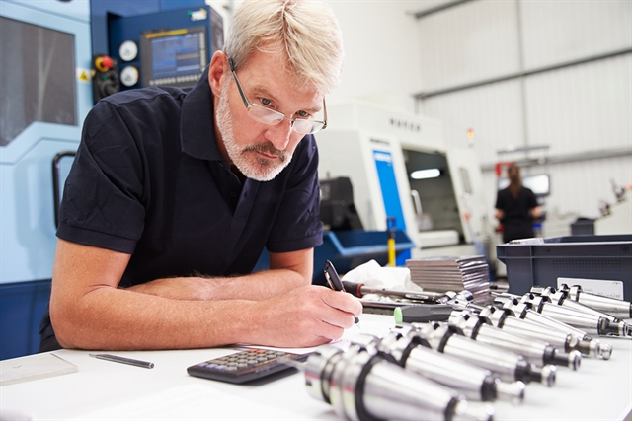
engineers
The engineers are responsible for figuring out how the final product will work. Depending on the product’s complexity, various different engineers may be required.
They will also work out the best and most efficient way for the product to go together, if it has multiple parts or if it requires the consumer to assemble it.

Slide 8
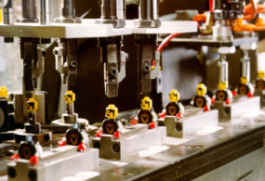
manufacturers
The manufacturers are the people that make the product.
Products today usually require various different forms of commercial manufacture. Large machines in factories produce components and assemble them. Some products will be assembled by hand or require some form of human input to produce the final product.

Slide 9

Marketing team
The marketing team are responsible for promoting the product to consumers in as many ways as possible.
Traditionally, this is done through adverts on TV, posters and billboards, magazines etc.
Nowadays, advertising online is the most effective way of reaching most consumers, due to the abundance of smart phones, tablets, laptops and computers that consumers use.
Social media is a particularly powerful tool to advertise a new product.

Slide 10

ergonomists
The ergonomists looks at the ergonomics (a design factors we will study later in more detail).
They are responsible for ensuring the product is comfortable to use and handle.
They are also responsible for ensuring that the product is easy to use, both in the way a person physically holds and interacts with it, as well as their understanding of how it works.

Slide 11

consumers
Consumers are the people who buy and use the products. They are essentially the customers who need or want a specific product for a specific purpose.
They will likely have seen an advertisement of the product which compelled them to buy it or they were recommended it by a friend or company, based on their needs and wants.

Slide 12
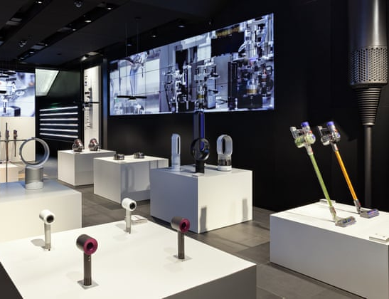
retailers
Retailers are the people who sell the products.
You may find specific stores selling the one brand e.g. Apple, Microsoft, Dyson.
You may also find stores that sell various brands, e.g. PC World.
Today, Amazon is one of the largest online retailers, allowing consumers to purchase almost every product available for home delivery.

Slide 13

Economists
Economists will look at the current economic climate before, during and after the product design and manufacture.
They will help determine when the best time to place a product on the market is, judging when the highest profits are likely to be made or when the greatest number of sales are likely to be made, e.g. Christmas is always a good time to release a new product due to the number of people shopping.

